Slide 1
Diyala University / College of Education for Humanities
Asst . Inst. Eman Ahmed Hasson
Methods of Teaching English
Second Grade
The Third Lecture
Observation

Slide 2
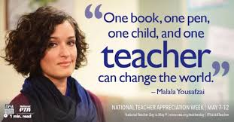

Slide 3
Examples of the observation process
A teacher wanted to explore her praising behavior . She audio taped her class of young teens with an open mind toward discovery.

Slide 4
She discovered that she verbalized ‘very good’ quite often.

Slide 5
She identified her frequent use of ‘very good’ as being ambiguous.

Slide 6
As such , she implement small changes in her praising behavior.

Slide 7
Observing other teachers
As Fanselow (1988) points out, as teachers, we can see our own teaching in the teaching of others.

Slide 8
Exploration through talk :
Talking about teaching can offer chances to learn about and reflect on our teaching.

Slide 9
Talking with Other Teachers about Observations
In addition to observing teaching, talking about the teaching we observe can offer chances to see our teaching differently.

Slide 10
How can teachers explore through a teacher journal?
We can explore teaching by writing in a journal . The purpose of writing in a journal is to have a place to record our observations of what goes in our own and other teachers’ classrooms.

